Slide 1
Decision Trees
color
color
Can represent arbitrary conjunction and disjunction. Can represent any classification function over discrete feature vectors.
Can be rewritten as a set of rules, i.e. disjunctive normal form (DNF).
  red ∧ circle → pos
  red ∧ circle → A
  blue → B; red ∧ square → B
  green → C; red ∧ triangle → C
red
blue
green
red
blue
green
shape
pos
shape
C
neg
B
circle
square
triangle
circle
square
triangle
pos
neg
neg
A
B
C

Slide 2
Properties of Decision Tree Learning
Continuous (real-valued) features can be handled by allowing nodes to split a real valued feature into two ranges based on a threshold
(e.g. length < 3 and length ≥3)
Classification trees have discrete class labels at the leaves, regression trees allow real-valued outputs at the leaves.
Algorithms for finding consistent trees are efficient for processing large amounts of training data for data mining tasks.
Methods developed for handling noisy training data (both class and feature noise).
Methods developed for handling missing feature values.

Slide 3
Top-Down Decision Tree Induction
Recursively build a tree top-down by divide and conquer.
<big, red, circle>: + <small, red, circle>: +
<small, red, square>: − <big, blue, circle>: −
color
red
blue
green
<big, red, circle>: +
<small, red, circle>: +
<small, red, square>: −

Slide 4
Top-Down Decision Tree Induction
Recursively build a tree top-down by divide and conquer.
<big, red, circle>: + <small, red, circle>: +
<small, red, square>: − <big, blue, circle>: −
color
red
blue
green
<big, red, circle>: +
<small, red, circle>: +
<small, red, square>: −
shape
neg
neg
circle
<big, blue, circle>: −
square
triangle
pos
neg
pos
<big, red, circle>: +
<small, red, circle>: +
<small, red, square>: −

Slide 5
Decision Tree Induction Pseudocode
DTree(examples, features) returns a tree
If all examples are in one category, return a leaf node with that category label.
Else if the set of features is empty, return a leaf node with the category label that
is the most common in examples.
Else pick a feature F and create a node R for it
For each possible value v_{i} of F:
Let examples_{i} be the subset of examples that have value v_{i} for F
Add an out-going edge E to node R labeled with the value v_{i.}
If examples_{i} is empty
then attach a leaf node to edge E labeled with the category that
is the most common in examples.
else call DTree(examples_{i} , features – {F}) and attach the resulting
tree as the subtree under edge E.
Return the subtree rooted at R.

Slide 6
Picking a Good Split Feature
Goal is to have the resulting tree be as small as possible, per Occam’s razor.
Finding a minimal decision tree (nodes, leaves, or depth) is an NP-hard optimization problem.
Top-down divide-and-conquer method does a greedy search for a simple tree but does not guarantee to find the smallest.
  General lesson in ML: “Greed is good.”
Want to pick a feature that creates subsets of examples that are relatively “pure” in a single class so they are “closer” to being leaf nodes.
There are a variety of heuristics for picking a good test, a popular one is based on information gain that originated with the ID3 system of Quinlan (1979).

Slide 7
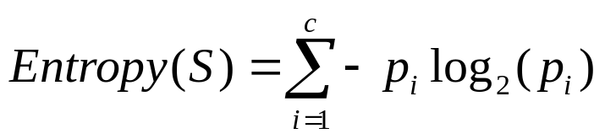
Entropy
Entropy (disorder, impurity) of a set of examples, S, relative to a binary classification is:
where p₁ is the fraction of positive examples in S and p₀ is the fraction of negatives.
If all examples are in one category, entropy is zero (we define 0⋅log(0)=0)
If examples are equally mixed (p₁=p₀=0.5), entropy is a maximum of 1.
Entropy can be viewed as the number of bits required on average to encode the class of an example in S where data compression (e.g. Huffman coding) is used to give shorter codes to more likely cases.
For multi-class problems with c categories, entropy generalizes to:

Slide 8
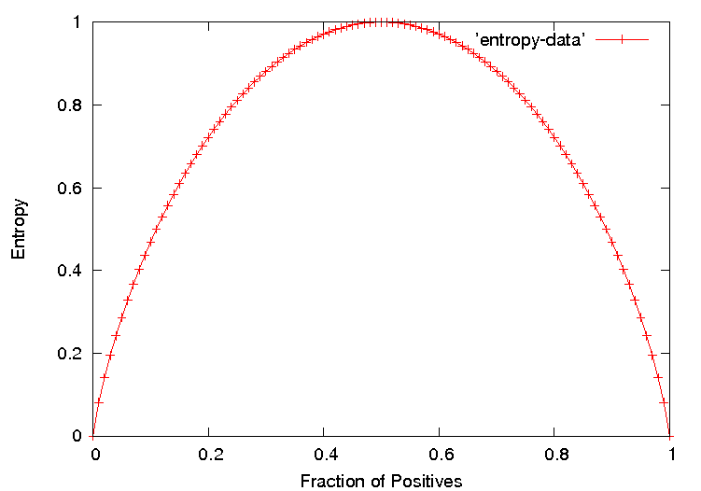
Entropy Plot for Binary Classification

Slide 9
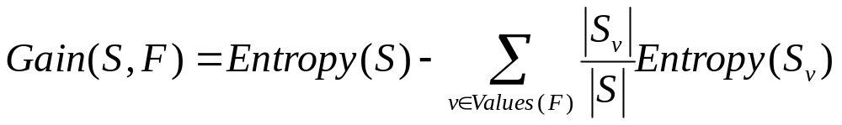
Information Gain
The information gain of a feature F is the expected reduction in entropy resulting from splitting on this feature.
where S_{v} is the subset of S having value v for feature F.
Entropy of each resulting subset weighted by its relative size.
Example:
  <big, red, circle>: + <small, red, circle>: +
  <small, red, square>: − <big, blue, circle>: −
2+, 2 −: E=1
size
2+, 2 − : E=1
color
2+, 2 − : E=1
shape
big small
1+,1− 1+,1−
E=1 E=1
red blue
2+,1− 0+,1−
E=0.918 E=0
circle square
2+,1− 0+,1−
E=0.918 E=0
Gain=1−(0.5⋅1 + 0.5⋅1) = 0
Gain=1−(0.75⋅0.918 +
0.25⋅0) = 0.311
Gain=1−(0.75⋅0.918 +
0.25⋅0) = 0.311

Slide 10
Hypothesis Space Search
Performs batch learning that processes all training instances at once rather than incremental learning that updates a hypothesis after each example.
Performs hill-climbing (greedy search) that may only find a locally-optimal solution. Guaranteed to find a tree consistent with any conflict-free training set (i.e. identical feature vectors always assigned the same class), but not necessarily the simplest tree.
Finds a single discrete hypothesis, so there is no way to provide confidences or create useful queries.

Slide 11
Bias in Decision-Tree Induction
Information-gain gives a bias for trees with minimal depth.
Implements a search (preference) bias instead of a language (restriction) bias.

Slide 12
History of Decision-Tree Research
Hunt and colleagues use exhaustive search decision-tree methods (CLS) to model human concept learning in the 1960’s.
In the late 70’s, Quinlan developed ID3 with the information gain heuristic to learn expert systems from examples.
Simulataneously, Breiman and Friedman and colleagues develop CART (Classification and Regression Trees), similar to ID3.
In the 1980’s a variety of improvements are introduced to handle noise, continuous features, missing features, and improved splitting criteria. Various expert-system development tools results.
Quinlan’s updated decision-tree package (C4.5) released in 1993.
Weka includes Java version of C4.5 called J48.

Slide 13
Weka J48 Trace 1
data> java weka.classifiers.trees.J48 -t figure.arff -T figure.arff -U -M 1
Options: -U -M 1
J48 unpruned tree
------------------
color = blue: negative (1.0)
color = red
| shape = circle: positive (2.0)
| shape = square: negative (1.0)
| shape = triangle: positive (0.0)
color = green: positive (0.0)
Number of Leaves : 5
Size of the tree : 7
Time taken to build model: 0.03 seconds
Time taken to test model on training data: 0 seconds

Slide 14
Weka J48 Trace 2
data> java weka.classifiers.trees.J48 -t figure3.arff -T figure3.arff -U -M 1
Options: -U -M 1
J48 unpruned tree
------------------
shape = circle
| color = blue: negative (1.0)
| color = red: positive (2.0)
| color = green: positive (1.0)
shape = square: positive (0.0)
shape = triangle: negative (1.0)
Number of Leaves : 5
Size of the tree : 7
Time taken to build model: 0.02 seconds
Time taken to test model on training data: 0 seconds

Slide 15
Weka J48 Trace 3
data> java weka.classifiers.trees.J48 -t contact-lenses.arff
J48 pruned tree
------------------
tear-prod-rate = reduced: none (12.0)
tear-prod-rate = normal
| astigmatism = no: soft (6.0/1.0)
| astigmatism = yes
| | spectacle-prescrip = myope: hard (3.0)
| | spectacle-prescrip = hypermetrope: none (3.0/1.0)
Number of Leaves : 4
Size of the tree : 7
Time taken to build model: 0.03 seconds
Time taken to test model on training data: 0 seconds
=== Error on training data ===
Correctly Classified Instances 22 91.6667 %
Incorrectly Classified Instances 2 8.3333 %
Kappa statistic 0.8447
Mean absolute error 0.0833
Root mean squared error 0.2041
Relative absolute error 22.6257 %
Root relative squared error 48.1223 %
Total Number of Instances 24
=== Confusion Matrix ===
a b c <-- classified as
5 0 0 | a = soft
0 3 1 | b = hard
1 0 14 | c = none
=== Stratified cross-validation ===
Correctly Classified Instances 20 83.3333 %
Incorrectly Classified Instances 4 16.6667 %
Kappa statistic 0.71
Mean absolute error 0.15
Root mean squared error 0.3249
Relative absolute error 39.7059 %
Root relative squared error 74.3898 %
Total Number of Instances 24
=== Confusion Matrix ===
a b c <-- classified as
5 0 0 | a = soft
0 3 1 | b = hard
1 2 12 | c = none

Slide 16
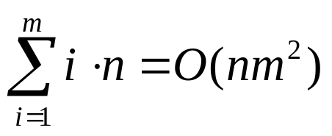
Computational Complexity
Worst case builds a complete tree where every path test every feature. Assume n examples and m features.
At each level, i, in the tree, must examine the remaining m− i features for each instance at the level to calculate info gains.
However, learned tree is rarely complete (number of leaves is ≤ n). In practice, complexity is linear in both number of features (m) and number of training examples (n).
⋅
F₁
⋅
⋅
⋅
Maximum of n examples spread across
all nodes at each of the m levels
⋅
F_{m}

Slide 17
Overfitting
Learning a tree that classifies the training data perfectly may not lead to the tree with the best generalization to unseen data.
  There may be noise in the training data that the tree is erroneously fitting.
  The algorithm may be making poor decisions towards the leaves of the tree that are based on very little data and may not reflect reliable trends.
A hypothesis, h, is said to overfit the training data is there exists another hypothesis which, h´, such that h has less error than h´ on the training data but greater error on independent test data.
on training data
on test data
accuracy
hypothesis complexity

Slide 18
Overfitting Example
Testing Ohms Law: V = IR (I = (1/R)V)
Experimentally
measure 10 points
Fit a curve to the
Resulting data.
current (I)
voltage (V)
Perfect fit to training data with an 9th degree polynomial
(can fit n points exactly with an n-1 degree polynomial)
Ohm was wrong, we have found a more accurate function!

Slide 19
Overfitting Example
Testing Ohms Law: V = IR (I = (1/R)V)
current (I)
voltage (V)
Better generalization with a linear function
that fits training data less accurately.

Slide 20
Overfitting Noise in Decision Trees
Category or feature noise can easily cause overfitting.
  Add noisy instance <medium, blue, circle>: pos (but really neg)
color
red
green
blue
shape
neg
neg
circle
square
triangle
pos
neg
pos

Slide 21
Overfitting Noise in Decision Trees
Category or feature noise can easily cause overfitting.
  Add noisy instance <medium, blue, circle>: pos (but really neg)
color
red
green
blue
<big, blue, circle>: −
<medium, blue, circle>: +
shape
neg
circle
square
triangle
small
med
big
pos
neg
pos
neg
pos
neg
Noise can also cause different instances of the same feature vector to have different classes. Impossible to fit this data and must label leaf with the majority class.
  <big, red, circle>: neg (but really pos)
Conflicting examples can also arise if the features are incomplete and inadequate to determine the class or if the target concept is non-deterministic.

Slide 22
Overfitting
Overfitting when our learning algorithm continues develop hypotheses that reduce training set error at the cost of an increased test set error.
According to Mitchell, a hypothesis, h, is said to overfit the training set, D, when there exists a hypothesis, h’, that outperforms h on the total distribution of instances that D is a subset of.
We can attempt to avoid overfitting by using a validation set. If we see that a subsequent tree reduces training set error but at the cost of an increased validation set error then we know we can stop growing the tree.

Slide 23
Overfitting Prevention (Pruning) Methods
Two basic approaches for decision trees
  Prepruning: Stop growing tree as some point during top-down construction when there is no longer sufficient data to make reliable decisions.
  Postpruning: Grow the full tree, then remove subtrees that do not have sufficient evidence.
Label leaf resulting from pruning with the majority class of the remaining data, or a class probability distribution.
Method for determining which subtrees to prune:
  Cross-validation: Reserve some training data as a hold-out set (validation set, tuning set) to evaluate utility of subtrees.
  Statistical test: Use a statistical test on the training data to determine if any observed regularity can be dismisses as likely due to random chance.
  Minimum description length (MDL): Determine if the additional complexity of the hypothesis is less complex than just explicitly remembering any exceptions resulting from pruning.

Slide 24
Reduced Error Pruning
A post-pruning, cross-validation approach.
Partition training data in “grow” and “validation” sets.
Build a complete tree from the “grow” data.
Until accuracy on validation set decreases do:
For each non-leaf node, n, in the tree do:
Temporarily prune the subtree below n and replace it with a
leaf labeled with the current majority class at that node.
Measure and record the accuracy of the pruned tree on the validation set.
Permanently prune the node that results in the greatest increase in accuracy on
the validation set.

Slide 25
Issues with Reduced Error Pruning
The problem with this approach is that it potentially “wastes” training data on the validation set.
Severity of this problem depends where we are on the learning curve:
test accuracy
number of training examples

Slide 26
Decision Tree Learning:
Rule Post-Pruning
In Rule Post-Pruning:
  Step 1. Grow the Decision Tree with respect to the Training Set,
  Step 2. Convert the tree into a set of rules.
  Step 3. Remove antecedents that result in a reduction of the validation set error rate.
  Step 4. Sort the resulting list of rules based on their accuracy and use this sorted list as a sequence for classifying unseen instances.

Slide 27
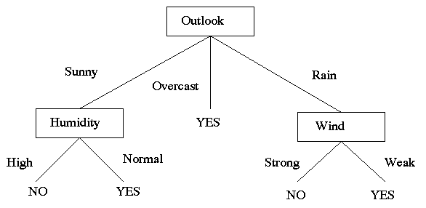
Decision Tree Learning:
Rule Post-Pruning
Given the decision tree:
Rule1: If (Outlook = sunny ^ Humidity = high ) Then No
Rule2: If (Outlook = sunny ^ Humidity = normal Then Yes
Rule3: If (Outlook = overcast) Then Yes
Rule4: If (Outlook = rain ^ Wind = strong) Then No
Rule5: If (Outlook = rain ^ Wind = weak) Then Yes

Slide 28
Decision Tree Learning:
Other Methods for Attribute Selection
The information gain equation, G(S,A), presented earlier is biased toward attributes that have a large number of values over attributes that have a smaller number of values.
The ‘Super Attributes’ will easily be selected as the root, result in a broad tree that classifies perfectly but performs poorly on unseen instances.
We can penalize attributes with large numbers of values by using an alternative method for attribute selection, referred to as GainRatio.

Slide 29
Decision Tree Learning:
Using GainRatio for Attribute Selection
Let SplitInformation(S,A) = - Σ^{v}_{i=1} (|S_{i}|/|S|) log₂ (|S_{i}|/|S|), where v is the number of values of Attribute A.
GainRatio(S,A) = G(S,A)/SplitInformation(S,A)

Slide 30
Decision Tree Learning:
Dealing with Attributes of Different Cost
Sometimes the best attribute for splitting the training elements is very costly. In order to make the overall decision process more cost effective we may wish to penalize the information gain of an attribute by its cost.
  G’(S,A) = G(S,A)/Cost(A),
  G’(S,A) = G(S,A)²/Cost(A) [see Mitchell 1997],
  G’(S,A) = (2^{G(S,A)} – 1)/(Cost(A)+1)^{w} [see Mitchell 1997]

Slide 31
Cross-Validating without Losing Training Data
If the algorithm is modified to grow trees breadth-first rather than depth-first, we can stop growing after reaching any specified tree complexity.
First, run several trials of reduced error-pruning using different random splits of grow and validation sets.
Record the complexity of the pruned tree learned in each trial. Let C be the average pruned-tree complexity.
Grow a final tree breadth-first from all the training data but stop when the complexity reaches C.
Similar cross-validation approach can be used to set arbitrary algorithm parameters in general.

Slide 32
Additional Decision Tree Issues
Better splitting criteria
  Information gain prefers features with many values.
Continuous features
Predicting a real-valued function (regression trees)
Missing feature values
Features with costs
Misclassification costs
Incremental learning
  ID4
  ID5
Mining large databases that do not fit in main memory

Slide 33
Learning Ensembles
Learn multiple alternative definitions of a concept using different training data or different learning algorithms.
Combine decisions of multiple definitions, e.g. using weighted voting.
Training Data
⋅ ⋅ ⋅ ⋅ ⋅ ⋅ ⋅ ⋅
Data1
Data2
Data m
Learner1
Learner2
⋅ ⋅ ⋅ ⋅ ⋅ ⋅ ⋅ ⋅
Learner m
⋅ ⋅ ⋅ ⋅ ⋅ ⋅ ⋅ ⋅
Model1
Model2
Model m
Model Combiner
Final Model

Slide 34
Value of Ensembles
When combing multiple independent and diverse decisions each of which is at least more accurate than random guessing, random errors cancel each other out, correct decisions are reinforced.
Human ensembles are demonstrably better
  How many jelly beans in the jar?: Individual estimates vs. group average.
  Who Wants to be a Millionaire: Expert friend vs. audience vote.

Slide 35
Homogenous Ensembles
Use a single, arbitrary learning algorithm but manipulate training data to make it learn multiple models.
  Data1 ≠ Data2 ≠ … ≠ Data m
  Learner1 = Learner2 = … = Learner m
Different methods for changing training data:
  Bagging: Resample training data
  Boosting: Reweight training data
  DECORATE: Add additional artificial training data
In WEKA, these are called meta-learners, they take a learning algorithm as an argument (base learner) and create a new learning algorithm.

Slide 36
Bagging
Create ensembles by repeatedly randomly resampling the training data (Brieman, 1996).
Given a training set of size n, create m samples of size n by drawing n examples from the original data, with replacement.
  Each bootstrap sample will on average contain 63.2% of the unique training examples, the rest are replicates.
Combine the m resulting models using simple majority vote.
Decreases error by decreasing the variance in the results due to unstable learners, algorithms (like decision trees) whose output can change dramatically when the training data is slightly changed.

Slide 37
Boosting
Originally developed by computational learning theorists to guarantee performance improvements on fitting training data for a weak learner that only needs to generate a hypothesis with a training accuracy greater than 0.5 (Schapire, 1990).
Revised to be a practical algorithm, AdaBoost, for building ensembles that empirically improves generalization performance (Freund & Shapire, 1996).
Examples are given weights. At each iteration, a new hypothesis is learned and the examples are reweighted to focus the system on examples that the most recently learned classifier got wrong.

Slide 38
Boosting: Basic Algorithm
General Loop:
Set all examples to have equal uniform weights.
For t from 1 to T do:
Learn a hypothesis, h_{t}, from the weighted examples
Decrease the weights of examples h_{t} classifies correctly
Base (weak) learner must focus on correctly classifying the most highly weighted examples while strongly avoiding over-fitting.
During testing, each of the T hypotheses get a weighted vote proportional to their accuracy on the training data.

Slide 39
AdaBoost Pseudocode
TrainAdaBoost(D, BaseLearn)
For each example d_{i} in D let its weight w_{i}=1/|D|
Let H be an empty set of hypotheses
For t from 1 to T do:
Learn a hypothesis, h_{t}, from the weighted examples: h_{t}=BaseLearn(D)
Add h_{t} to H
Calculate the error, ε_{t}, of the hypothesis h_{t} as the total sum weight of the
examples that it classifies incorrectly.
If ε_{t} > 0.5 then exit loop, else continue.
Let β_{t} = ε_{t} / (1 – ε_{t} )
Multiply the weights of the examples that h_{t} classifies correctly by β_{t}
Rescale the weights of all of the examples so the total sum weight remains 1.
Return H
TestAdaBoost(ex, H)
Let each hypothesis, h_{t}, in H vote for ex’s classification with weight log(1/ β_{t} )
Return the class with the highest weighted vote total.

Slide 40
Learning with Weighted Examples
Generic approach is to replicate examples in the training set proportional to their weights (e.g. 10 replicates of an example with a weight of 0.01 and 100 for one with weight 0.1).
Most algorithms can be enhanced to efficiently incorporate weights directly in the learning algorithm so that the effect is the same (e.g. implement the WeightedInstancesHandler interface in WEKA).
For decision trees, for calculating information gain, when counting example i, simply increment the corresponding count by w_{i} rather than by 1.

Slide 41
Experimental Results on Ensembles
(Freund & Schapire, 1996; Quinlan, 1996)
Ensembles have been used to improve generalization accuracy on a wide variety of problems.
On average, Boosting provides a larger increase in accuracy than Bagging.
Boosting on rare occasions can degrade accuracy.
Bagging more consistently provides a modest improvement.
Boosting is particularly subject to over-fitting when there is significant noise in the training data.

Slide 42
DECORATE
(Melville & Mooney, 2003)
Change training data by adding new artificial training examples that encourage diversity in the resulting ensemble.
Improves accuracy when the training set is small, and therefore resampling and reweighting the training set has limited ability to generate diverse alternative hypotheses.

Slide 43
Overview of DECORATE
Current Ensemble
Training Examples
+
-
C1
-
+
+
Base Learner
+
+
-
+
-
Artificial Examples

Slide 44
Overview of DECORATE
Current Ensemble
Training Examples
+
-
C1
-
+
+
Base Learner
C2
-
+
-
-
+
-
-
-
+
+
Artificial Examples

Slide 45
Overview of DECORATE
Current Ensemble
Training Examples
+
-
C1
-
+
+
Base Learner
C2
-
+
+
C3
+
-
Artificial Examples

Slide 46
Ensembles and Active Learning
Ensembles can be used to actively select good new training examples.
Select the unlabeled example that causes the most disagreement amongst the members of the ensemble.
Applicable to any ensemble method:
  QueryByBagging
  QueryByBoosting
  ActiveDECORATE

Slide 47
Active-DECORATE
Unlabeled Examples
Utility = 0.1
Current Ensemble
Training Examples
C1
+
+
-
C2
+
-
DECORATE
+
C3
+
-
C4
+

Slide 48

Active-DECORATE
Unlabeled Examples
Utility = 0.1
0.9
0.3
0.2
0.5
Current Ensemble
Training Examples
C1
+
+
-
C2
+
-
DECORATE
+
C3
-
-
+
C4
-
Acquire Label

Slide 49
Issues in Ensembles
Parallelism in Ensembles: Bagging is easily parallelized, Boosting is not.
Variants of Boosting to handle noisy data.
How “weak” should a base-learner for Boosting be?
What is the theoretical explanation of boosting’s ability to improve generalization?
Exactly how does the diversity of ensembles affect their generalization performance.
Combining Boosting and Bagging.

